Slide 1
Detect Obstacles and Notify
電機六 B03208039 鐘友隸
June 4, 2021

Slide 2
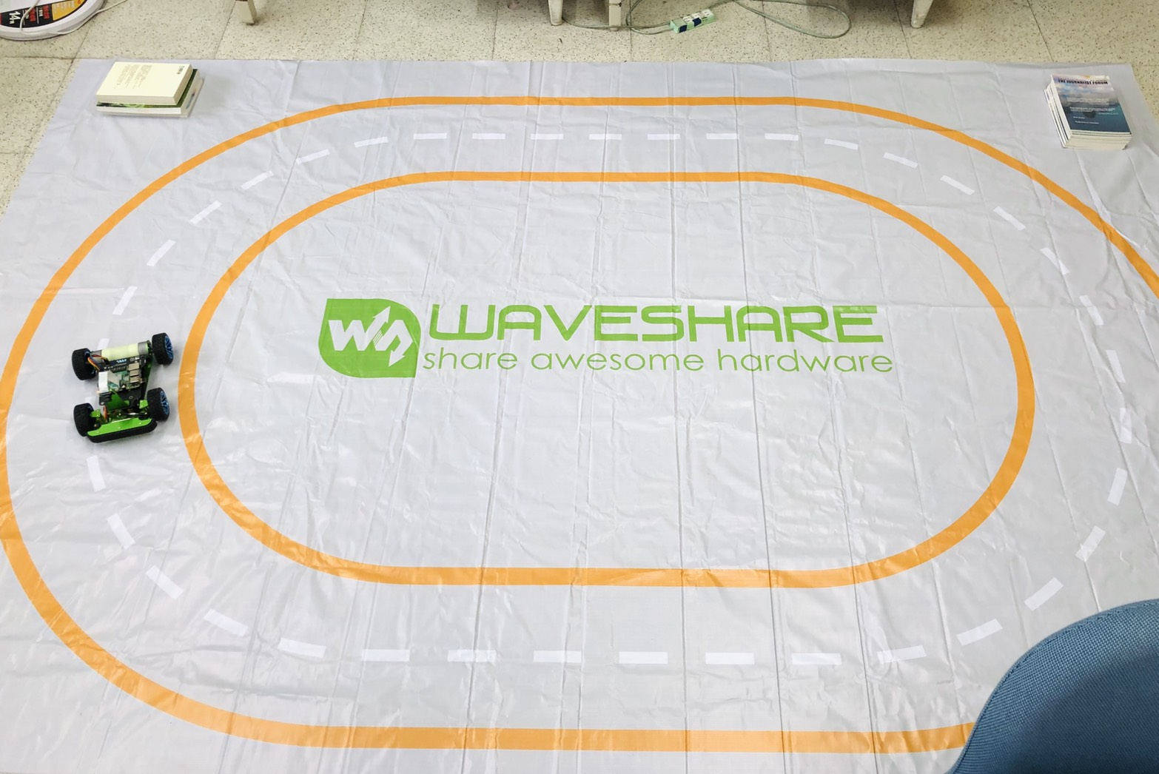
Goal
IR Distance Interrupter
Ultrasonic Ranging Module
Obstacle

Slide 3
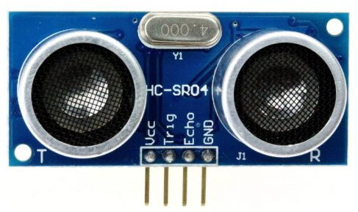
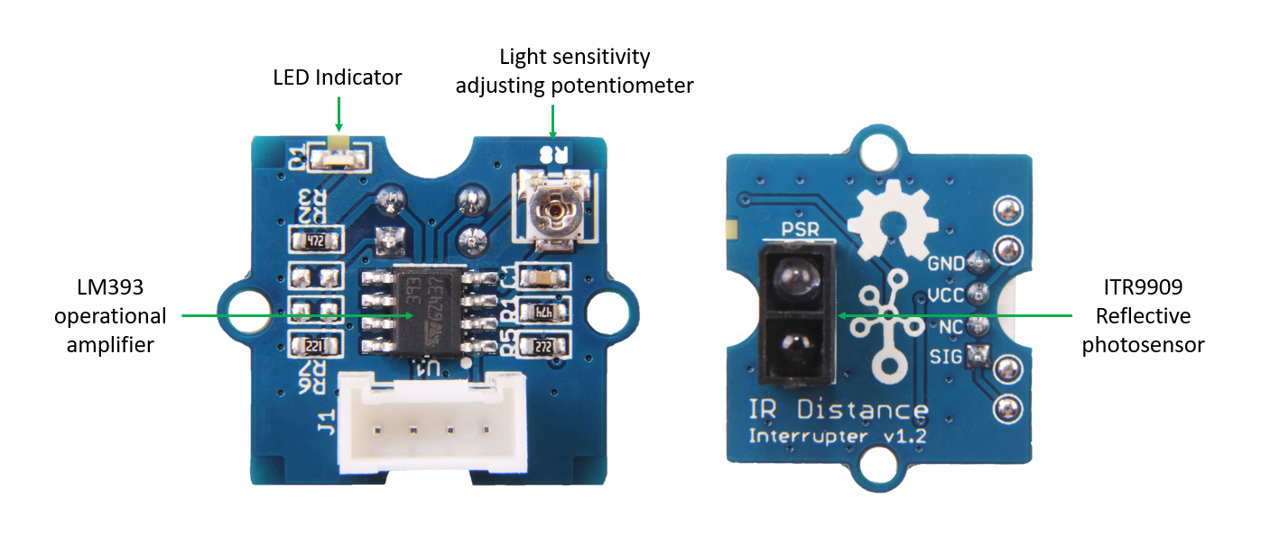
Tasks Completed
Car Manufacture
Autopilot
Delete all .decode(“utf8”) in /home/pi/.local/lib/python3.7/site-packages/tensorflow_core/python/keras/saving/hdf5_format.py
Basic
Obstacle avoidance through simple training is not possible
Ranging Modules
Ultrasonic: HC-SR04
IR: Grove - IR Distance Interrupter v1.2

Slide 4
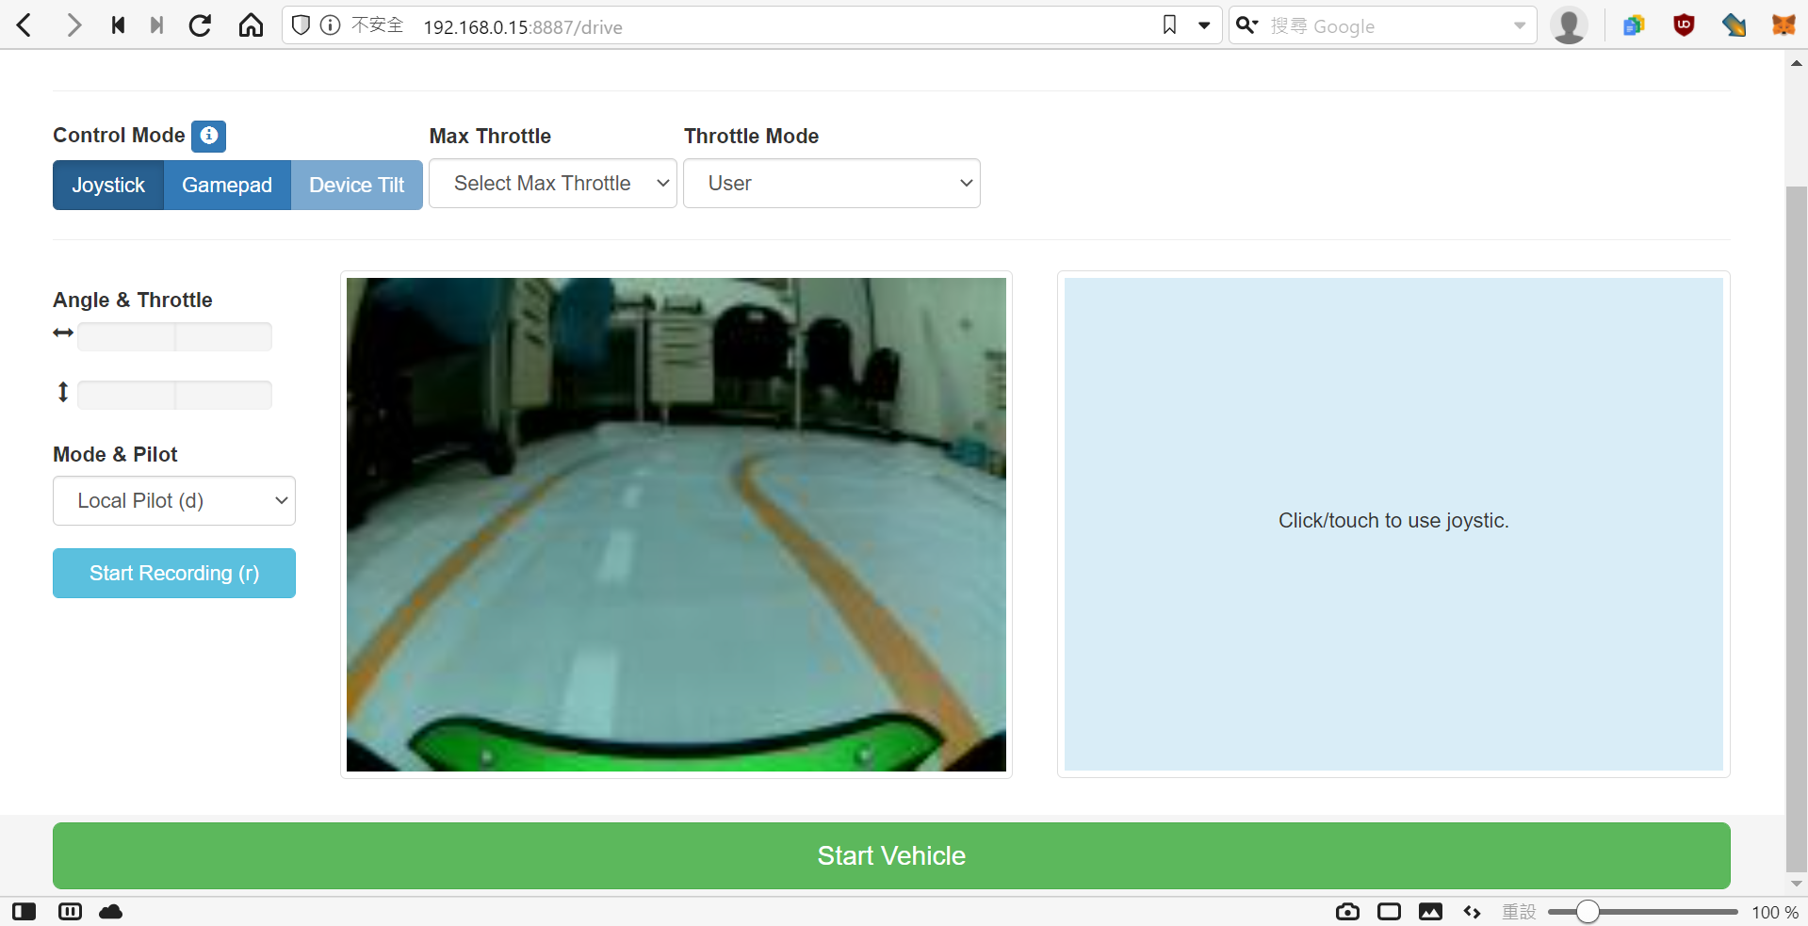
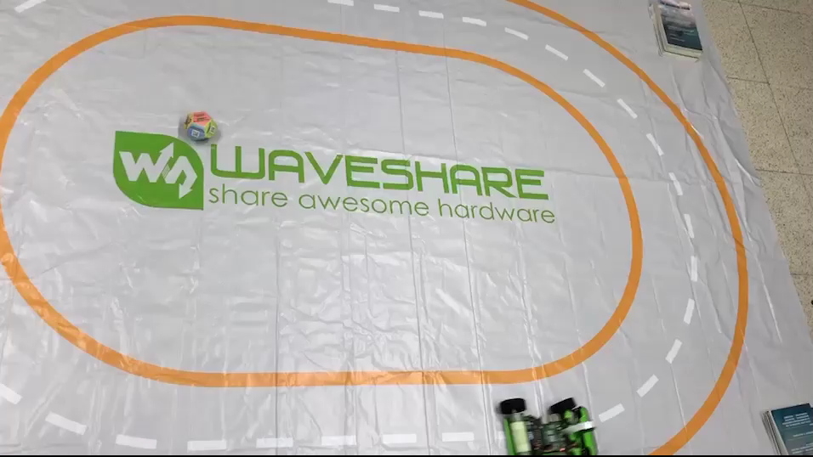
Task Completed (Cont.)

Slide 5
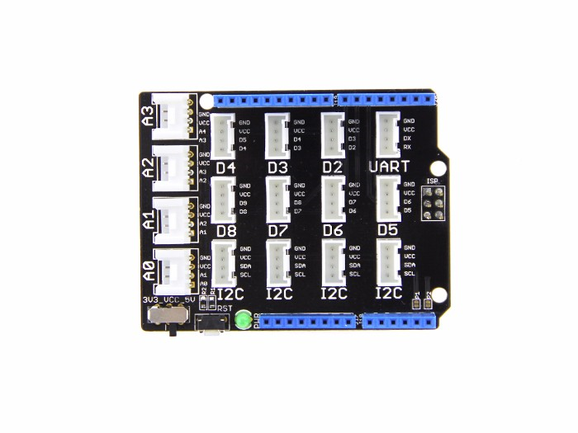
Ongoing
Ultrasonic Ranging Module
Mbed library available
https://os.mbed.com/teams/TVZ-Mechatronics-Team/code/HCSR04/
IR Distance Interrupter
Haven’t found existing library yet
Might put it aside
Bought a base shield

Slide 6
Pending
(Sorted by priority)
Notification from STM32
WebSocket
BLE
Override Settings
Change mode
Change throttle?
IR Distance Interrupter
Calculate passing speed

